Slide 1

Implementing Cross-Attention-only Time Series transformer for Commodity Prediction
Koushik Selvaraj
RA2412049015105
Zeroth Review
Date: 24-08-2025
1

Slide 2

Title Identification
Commodity Price Forecasting using Cross-Attention-only Transformer (CATS) and Benchmarking against ARIMA
Domain: Time Series Forecasting / Financial Econometrics
Application: Commodity prices (e.g., crude oil, gold, agricultural)
Objective: Evaluate whether modern deep learning (CATS) can outperform classical ARIMA in forecasting short- and long-term horizons.

Slide 3
One-Page Abstract
Problem Statement: Commodity prices are volatile, non-stationary, and influenced by multiple macro & seasonal factors. Accurate forecasting is essential for hedging, trading, and policy planning.
Motivation: ARIMA (Auto-Regressive Integrated Moving Average) widely used models but have limitations, particularly in handling long-term forecasts and capturing non-linear patterns because they are built on the assumption of linear relationships within the time series. struggles with long horizons & nonlinear patterns. Newer architectures like CATS show promise in capturing long-range dependencies efficiently.
Methodology:
Collect commodity price data (daily/weekly).
Train/Test CATS on historical windows, compare against ARIMA baselines.
Evaluate across multiple horizons (1-day, 5-day, 20-day).
Expected Outcome: Demonstrate whether CATS achieves better accuracy (MAE, RMSE, sMAPE) and efficiency compared to ARIMA.

Slide 4
One-Page Abstract
Time series forecasting is crucial for applications across multiple domains and various scenarios. Although Transformers have dramatically advanced the landscape of forecasting, their effectiveness remains debated.
Recent findings have indicated that simpler linear models might outperform complex Transformer-based approaches, highlighting the potential for more streamlined architectures.
In this paper, we shift the focus from evaluating the overall Transformer architecture to specifically examining the effectiveness of self-attention for time series forecasting. To this end, we introduce a new architecture, Cross-Attention-only Time Series transformer (CATS), that rethinks the traditional transformer framework by eliminating self-attention and leveraging cross-attention mechanisms instead.
By establishing future horizon-dependent parameters as queries and enhanced parameter sharing, our model not only improves long-term forecasting accuracy but also reduces the number of parameters and memory usage.
Extensive experiment across various datasets demonstrates that our model achieves superior performance with the lowest mean squared error and uses fewer parameters compared to existing models.

Slide 5
One-Page Abstract
⚡ Cross-Attention Only Time Series transformer
CATS removes self-attention and retains only cross-attention in its transformer architecture. This design choice aims to better preserve temporal information in time series forecasting, addressing the potential loss of such information during the embedding process in traditional transformer models.
⚡ Time and Memory Efficiency
CATS achieves improved time and memory efficiency compared to traditional self-attention-based transformers. While self-attention complexity grows quadratically with input length (O(L2)), CATS' cross-attention-only approach scales linearly (O(LT)).
⚡ Enhanced Parameter Sharing
CATS implements extensive parameter sharing across all layers and dimensions for each horizon-dependent query. This approach, including shared projection layers, significantly reduces parameter count and improves computational efficiency in both training and inference phases.

Slide 6
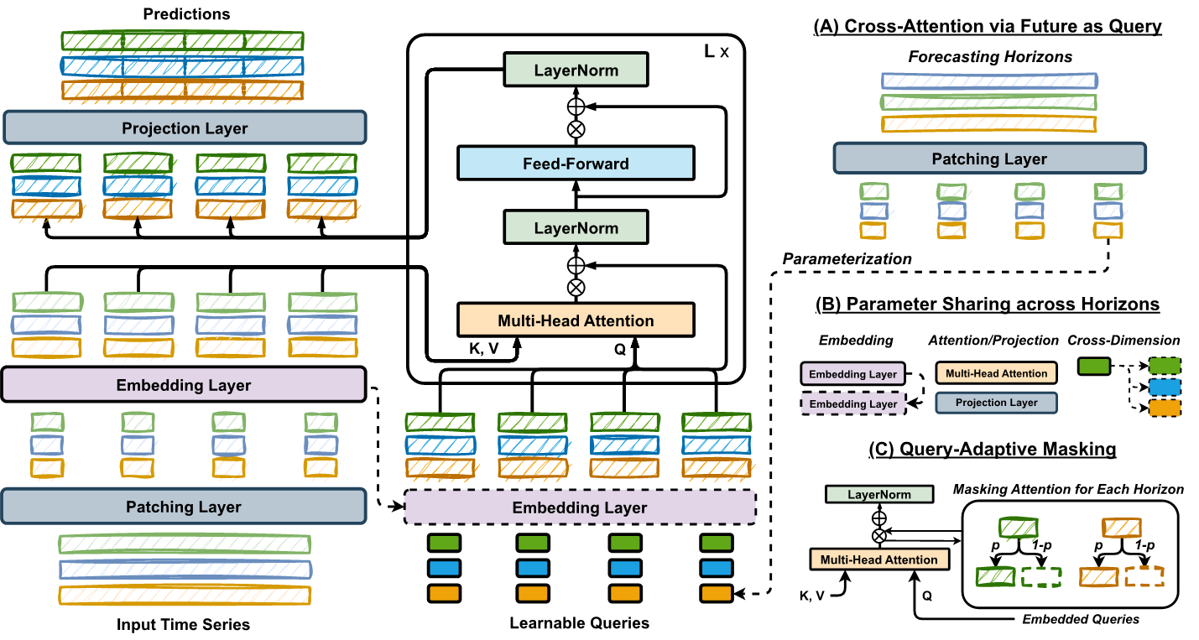
Architecture Diagram

Slide 7
Literature Review
ARIMA Models: Traditional statistical forecasting; strong for stationary short-term series but limited for nonlinearities.
PatchTST (ICLR 2023): Channel-independent patching improves Transformers for time series.
“Are Transformers Effective for Time Series?” (2023): Simple linear models (DLinear) often rival Transformers.
iTransformer (ICLR 2024): Variable-as-token approach; strong multivariate forecasting.
TimeMixer (2024): Pure MLP-based multiscale mixing; challenges attention-based dominance.
CATS (NeurIPS 2024): Removes self-attention, uses horizon-aware cross-attention; efficient, strong in long-term forecasting.

Slide 8
Literature Review
The NeurIPS 2024 Paper (CATS): What’s New
Core question. Instead of debating “Transformers vs. linear models,” the paper isolates the role of self-attention itself and asks whether it is necessary for time-series forecasting. proceedings.neurips.cc
Key idea.
The authors propose CATS (Cross-Attention-only Time-Series transformer) Remove all self-attention.
Treat future horizons as learnable queries; treat past history as keys/values (pure cross-attention).
Introduce parameter sharing across horizons and query-adaptive masking to improve efficiency and long-horizon accuracy. proceedings.neurips.cc
Empirics. On common datasets (e.g., ETT, Electricity, Weather, Traffic), CATS reports lower MSE/MAE and dramatically flatter parameter/memory growth as look-back length increases, compared with PatchTST, TimeMixer, and DLinear. Figures and tables show state-of-the-art or near-SOTA accuracy with fewer parameters and lower memory, especially for long inputs. proceedings.neurips.cc
Ablations/diagnostics. Replacing PatchTST’s self-attention with linear layers preserved or improved accuracy, especially for longer horizons—supporting the claim that self-attention may hinder temporal signal retention in some LTSF settings

Slide 9
Novelty Proposal
Gap Identified:
CATS proven on benchmark datasets (ETT, Electricity, Weather, Traffic).
No prior evaluation on financial/commodity markets with heavy non-stationarity & structural breaks.
The Dataset used in CATS Paper are not complex dataset
Novelty:
First empirical study of CATS on commodity price forecasting.
Use CATS in complex Dataset Industrial standard one
Benchmark against ARIMA (industry standard) / Informer / Autoformer.

Slide 10
Proposed System with Time Frame
System Workflow:
Data Collection – historical commodity price series (Brent/Gold/Agri futures).
Preprocessing – log/returns, scaling, rolling windows.
Baseline Models – Naïve RW, ARIMA/ARIMAX.
Deep Model – Implement CATS with horizon queries.
Evaluation – Metrics (MAE, RMSE, sMAPE, MASE), Diebold-Mariano tests.
Analysis – Horizon-wise performance, volatility regime comparison.
Time Frame (tentative):
Week 1–2: Data acquisition & cleaning
Week 3–4: Baseline ARIMA setup & backtests
Week 5–7: CATS implementation & training
Week 8: Evaluation & comparisons
Week 9–10: Results consolidation & report

Slide 11
References

